Slide 1
CHARACTERISTICS OF THE ARABIC LANGUAGE
Marwa F. Mohamed

Slide 2
Agenda
Introduction
Characteristics of Arabic Language
Arabic Grammar
Arabic Morphology
Building block of Arabic
Arabic sentence
Challenges in Arabic Natural Language Processing

Slide 3
Introduction
To effectively build a good Arabic software, one should fully understand the main characteristics of the Arabic language.
The Arabic language has many unique features that are different from many other languages.

Slide 4
CHARACTERISTICS OF THE ARABIC LANGUAGE
Arabic is written and read from right to left.
While text is written from right to left, numbers can be written and read from right to left. or from left to right.
Most Arabs read numbers and write them from left to right.

Slide 5


CHARACTERISTICS OF THE ARABIC LANGUAGE
It has 28 basic characters.
In addition to the basic 28 characters, Arabic has special letters such as
and HAMZA letters such as

Slide 6

CHARACTERISTICS OF THE ARABIC LANGUAGE
Even though the basic alphabet consists of 28 letters, it is extended to some 90 elements by additional shapes, marks, and vowels.
Some Arabic characters can be fused to form new shapes. For example, ‘لآ' 1s composed of ‘ل' and ‘آ'. ‘آ' is also composed

Slide 7
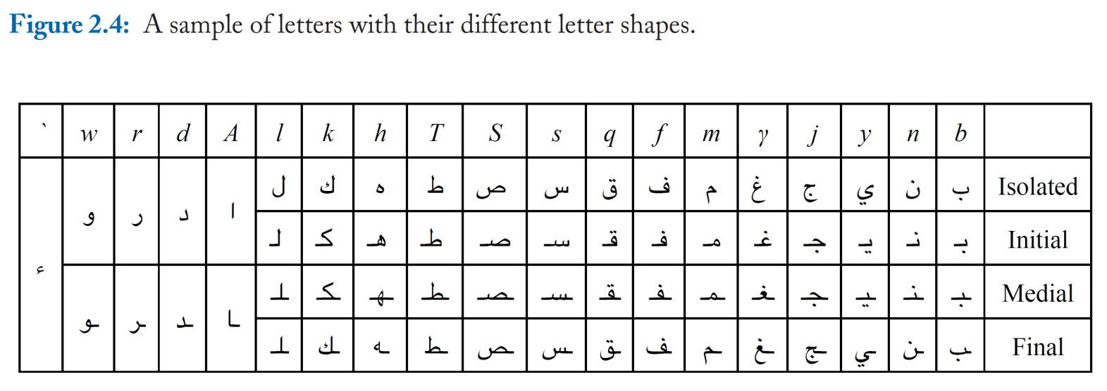
CHARACTERISTICS OF THE ARABIC LANGUAGE
Letters have up to four different forms: isolated, at the beginning, in the middle, and at the end of a word.
Most of the characters have three shapes depending on their position within the word.

Slide 8
CHARACTERISTICS OF THE ARABIC LANGUAGE
All characters are consonants except the letters Alif, Waw, and Ya.
Actually, these three characters are consonants with attached vowel sounds.
No upper or lower cases exist in Arabic.

Slide 9
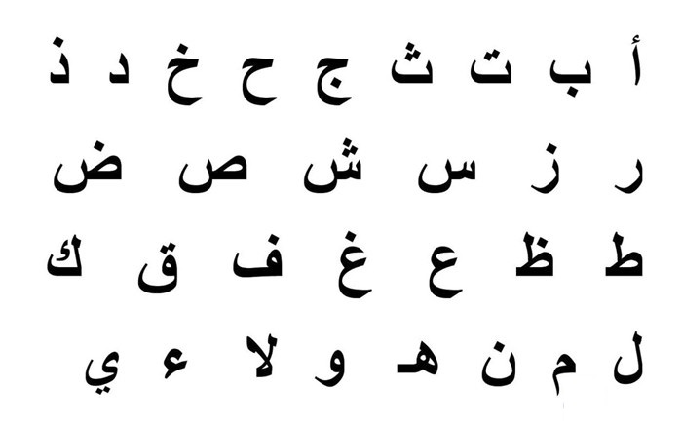
CHARACTERISTICS OF THE ARABIC LANGUAGE
Most characters (17 out of 28) have a dot, two dots, or three dots associated with the character and can be above, below, or inside the character.
The dots and their positions are important in distinguishing between different characters.

Slide 10
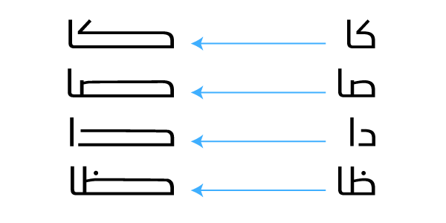
CHARACTERISTICS OF THE ARABIC LANGUAGE
Arabic also may use stretch character forms to add emphasis or aesthetics to the written word.

Slide 11
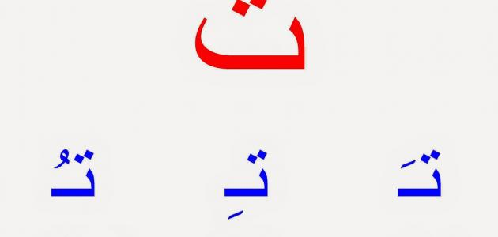
CHARACTERISTICS OF THE ARABIC LANGUAGE
Similar to accent marks in European languages, Arabic has diacritical signs.
These signs are used to mark short vowels and emphasize or loosen a letter's sound.

Slide 12
CHARACTERISTICS OF THE ARABIC LANGUAGE
The pronunciation of the character, and hence the meaning of the word containing that character, differs according to the diacritic imposed over it.
For example,
‘جُمَلَ‘ (sentences) is completely deferent from
‘جَمَلَ‘ ( camel) even though they have the same set of characters

Slide 13
CHARACTERISTICS OF THE ARABIC LANGUAGE
Arabic is a cursive script --like English handwriting-- links the letters of a single word.
The Arabic characters are written cursively with frequent vertical overlap in handwritten form.
For example, the first three characters of ‘محمد' can be written by hand above each other. Even in the printed characters, vertical overlapping is clear in the first two characters in the last example.

Slide 14
CHARACTERISTICS OF THE ARABIC LANGUAGE
Arabic Language is a derivational language (Based on a Root).
Arabic Language take the root and then forms on patterns.
Root like: ( ق و ل)
can be forms to: قال، قول، قيل، يقول

Slide 15
CHARACTERISTICS OF THE ARABIC LANGUAGE
The structure of Arabic language is different from that of indo-European languages, including English.
For instance, the phrase "PACKED ARRAY'' should be reversed in Arabic to " مصفوفة مربوطة ".
This is because in the Arabic language the adjective follows the nominal phrase, contrary to the English.

Slide 16
CHARACTERISTICS OF THE ARABIC LANGUAGE
The Arabic language accepts the principle of abbreviation.
Both types of abbreviation, forming a word from the first letters of a sequence -of words and selecting a prefix or a postfix from a word was popular in many Arabic works of literature.
For examples:
Arabs used to write " صلعم" to stand for " صلى الله على وسلم",
" اهـ" as a an abbreviation for " انتهى "

Slide 17
Arabic Grammar
Study of the science of Classical Arabic requires the study of it’s two major sub-sciences,
– الصرفMorphology – the study of the patterns of vowelization which convey tense and voice, and the suffixes that reflect the gender etc. of the subjects of verbs.
– النحو Syntax – the study of how words are arranged to form meaningful sentences, and how grammatical structure is determined by the endings of the three parts of speech.

Slide 18
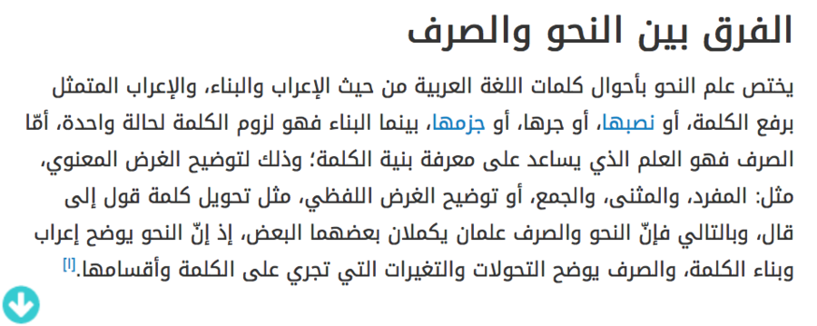
Arabic Grammar

Slide 19
Arabic Morphology
It deals with how to construct individual words and specifically verbs into the various tenses of past, present and future.
Morphology = study of structure of words
Morpheme = smallest unit that has semantic meaning
Ex:
"unbreakable" has three morphemes: “un”+ “break” + “able”
"roses" has 2 morphemes: “rose” (the object) + plural “s”

Slide 20
Building block of Arabic
The main building block of Arabic is a Word.
Arabic language linguists classify words in Arabic into three main categories:
Nouns: name of a person, place, or object and does not have any tense.
Verbs: that word which denotes an action and has tense.
Particles: that word of which cannot be understood without joining a noun or a verb or both.
Every word in the Arabic dictionary falls into one of these three categories.

Slide 21
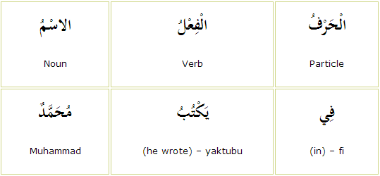

Slide 22
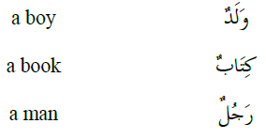
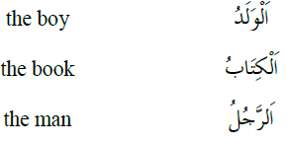
Noun
Noun : not linked to time, Arabic nouns are either indefinite or definite.
Indefinite | Definite
take a tanwīn on their final letter, and are generally translated into English using the word 'a | fix the word الــto the beginning of the word. This is generally translated using the word 'the'

Slide 23
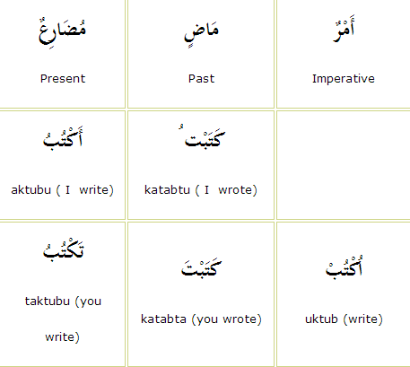
Verb
Verb: is a word that denotes an action or state in the past, present or imperative. it dependent on time
Ex:
کُنتُ I was, کَتَبتُ I wrote,
اُکتُب (you) write , کُن be,
اکُونُ I am , اکتُبُ I write,

Slide 24
Verb
All present verbs start with one of the following letters (أ، ي، ت، ن ) which are called the present form letters حُرُوفُ الْمُضَارَعَةِ, that is the letters that have to do with the present verb only.
الْفِعْلُ Verb in present tense | حُرُوفُ الْمُضَارَعَةِ Present verb letters | Pronoun
نَكْتُبُ naktubu (we are writing) | نَ nūn | نَحْنُ We
يَكتبون yaktubūna (they are writing) | يَـ ya | هُمْ they
أَكْتُبُ aktubu (I am writing) | أَ hamza | أَنَا I
تَكْتُبُون taktubūna (you write) | تَ Ta | أَنْتُمْ

Slide 25
Particles
Particles : only be understood after coupling either a noun or a verb to it Prepositions are examples of particles
Particle -Arabic | Type (English) | Type (Arabic)
مِنْ، إلَى، فِي | Prepositions | حُرُوفُ جَرٍّ
وَ، فَ، أَوْ، ثُمَّ | Conjunctions | حُرُوفُ الْعَطْفِ
هَلْ، أَ | Interrogative particles | حُرُوفُ اِسْتِفْهَامٍ
يَا | vocative particle | حَرْفُ نِدَاء

Slide 26
Arabic sentence
Arabic sentence has two types:
Nominal sentence : begin with a noun or a pronoun
Verbal sentence: begin with a verb
An Arabic nominal sentence consists of a subject (مبتدأ) and a predicate (خبر).

Slide 27
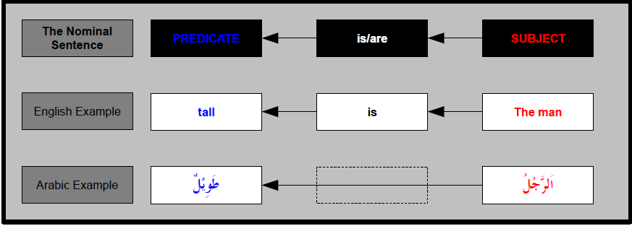
Nominal Sentence
The Nominal Sentence : is the most basic sentence in Arabic.
This is of the form 'X is/are Y', such as 'The boy is tall', or 'The books are big.‘ X is usually a definite noun, and is known as the subject. Y is usually an indefinite noun or an indefinite adjective, and is called the predicate.
In Arabic we don't have a word for 'is/are' in the nominal sentence.

Slide 28

Nominal Sentence
We can replace the subject of a nominal sentence with a pronoun.
Ex: rather than saying 'The man is tall', we might want to say, 'He is tall'.
The Arabic pronouns we use for this replacement are called the detached pronouns.

Slide 29
Nominal Sentence
Using 'And' in the Nominal Sentence : The word for 'and' in Arabic is و .
'And' can also be used to link two nominal sentences together:

Slide 30
Verbal Sentence
An Arabic verbal sentence: begin with a verb, and they have at least a verb (فعل ) and a subject (فاعل )
The subject can be indicated by the conjugation of the verb, and not written separately
Examples:
أعمل.
“I work.”
درسنا.
“We studied.”
يعمل جدّي في التجارة.
My grandfather works in trade.

Slide 31
Verbal Sentence
A simple verbal sentence may be described in terms of four elements:
1- Verb and Object: a verb is either intransitive لازم or transitive متعدي
intransitive: نام الطفل
Transitive verbs can be:
monotransitive: استقبل علي الضيف
ditransitive: أعطيت الولد هدية

Slide 32
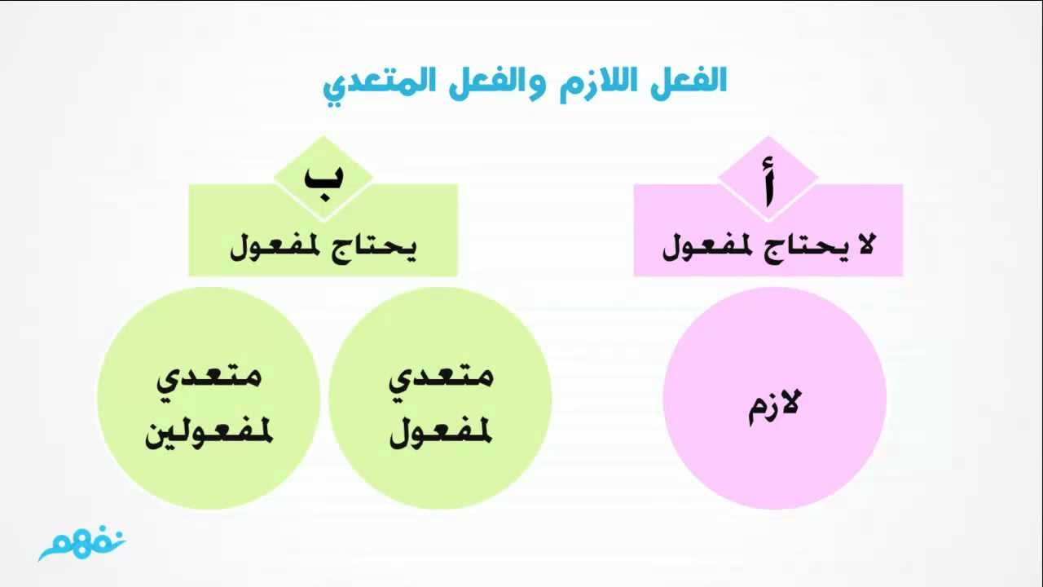

Slide 33
Verbal Sentence
2- Subject الفاعل : the agent is either:
- اسم صريحexplicit noun حضر الرئيس
or
- ضمير مستتر implicit pronoun جاء متأخرا
3- Deputy Agent نائب الفاعل in the passive sentence, the object of the corresponding active sentence becomes a deputy agent.
أُعطي الفائز جائزة

Slide 34
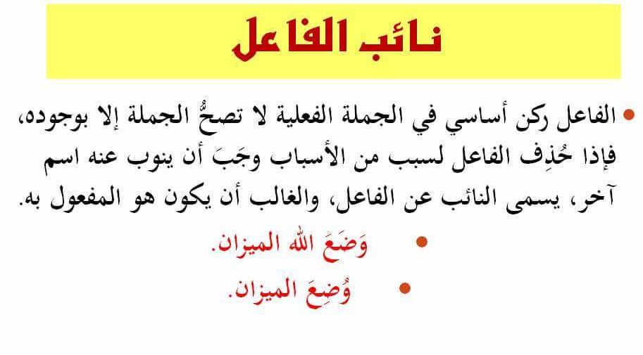

Slide 35
Verbal Sentence
4- Adverbial الظرف : An adverbial can be realised by adverbs, prepositional phrases and the circumstantial accusative الحال
Adverb: جاء أمس
Prepositional Phrase: إلى المدرسة ذهب
Circumstantial accusative: نائمًا رأيته

Slide 36
Challenges in Arabic Natural Language Processing

Slide 37
Agenda
NLP
Types characterize Arabic
Challenges of Arabic language
Orthographic الهجاء
Morphological الصرف
Syntactic levels النحو

Slide 38
Natural Language Processing (NLP)
is a domain of computer science
aims at facilitating communication between
machines (computers that understand machine language or programming language) and
human beings (who communicate and understand natural languages like English, Arabic and Chinese etc.)
Many applications these days use concepts from NLP.

Slide 39
Types characterize Arabic
Classical Arabic
Modern Standard Arabic (MSA)
Dialect Arabic or “colloquial Arabic”

Slide 40
Types characterize Arabic
Classical Arabic
is primarily use in Arabic speaking countries, as opposed to within the diaspora.
is found in religious writings such as the Sunnah and Hadith, and numerous historical documents.
Diacritic marks (also known as “Tashkil” or short vowels) are commonly used within Classical Arabic as phonetic guides to show the correct pronunciation.

Slide 41
Types characterize Arabic
Modern Standard Arabic (MSA)
is used for TV, newspapers, poetry and in books.
Arabic Courses at the Arab Academy are also taught in the Modern Standard form.
The MSA can be transformed to adapt to new words that need to be created because of science or technology.

Slide 42
Types characterize Arabic
Dialect Arabic or “colloquial Arabic”
is casually utilized daily by Arabs.
It is found in various nations and districts of a nation.
It is grouped into Mesopotamian Arabic, Arabian Peninsula Arabic, Syro Palestanian Arabic, Egyptian and Maghrebi Arabic.

Slide 43
Challenges
Challenges of Arabic language with regard to its characteristics and their related computational problems at
Orthographic
Morphological
Syntactic levels

Slide 44
Arabic orthography

Slide 45
Arabic orthography
Within the orthographic patterns of the written words, the shape of a letter can be changed depending on whether it is connected with a former and subsequent letter, or just connected with a former letter.
For example, the shapes of the letter ف changes depending on whether it occurs in the beginning, middle, or end of a word, respectively.

Slide 46
Arabic orthography
Arabic orthography includes a set of orthographic symbols, called diacritics, that carry the intended pronunciation of words.
Arabic orthography includes 28 letters, all letters are consonants except three long vowels: أ و ي
Unfortunately, MSA is devoid of diacritical markings and the restoration of these diacritics is an important task for other NLP applications such as text to speech.

Slide 47
Lack of consistency in orthography
Hamza Spelling
The most critical use of Hamza letter ء brings in more challenges.
With the very significance of Hamza being an additional letter seen at the top or bottom of the letters following the sounds of
As these rules are confusing even for native speakers, Hamza is ignored most of the time while typing.
NLP based systems should handle this assumption

Slide 48


Hamza Spelling
There are many orthographical forms of the Hamza letter “the seat of Al-Hamza”.
Which is decided by the diacritics (“Tashkeel”) of both the “Hamza” itself as well as the letter preceding it, i.e. either “Fatha”, “Dama”, “kasra” or “Sukun”.
Exceptionally, when Hamza comes at the beginning of the word, we always write it over an

Slide 49
Hamza Spelling
According to its appearance and pronunciation, there are two types of Hamza: Hamza Al-Qata and Hamza Al-Wasl.
Distinguishing each type is a challenge for both text and speech processing.
Hamza Al-Qata’ is the regular Hamza and is always written and pronounced, e.g. أنا
On the contrary, Hamza Al-Wasl is neither written nor pronounced unless it is at the start of the utterance; a bare ا is used instead.

Slide 50
Hamza Spelling
Simple rule to recognize Hamza Al-Wasl is to add waw, and before it and see whether or not it is pronounced; hence, written.
For example, the Hamza in iq-ra' AL’Kitab إقرأ الكتاب, read the book, is pronounced and written.
However, if we add waw, and at the beginning of sentence as in واقرأ الكتاب waq-ra’ Al-Kitab, and read the book. the Hamza is neither pronounced nor written.

Slide 51
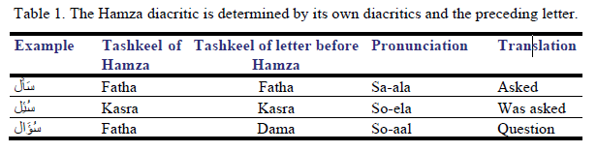
Hamza Spelling
When the diacritic mark of the “Hamza” is either “Fatha” or “Dama”, the Hamza appears at the middle or the end of a word and is written over the letter.
Table 1 presents some examples with the addition of the Hamza and the challenge it brings in causing orthographic confusion.

Slide 52
Hamza Spelling
Al-Hamza orthographic variants are non-standard ways to spell a specific variant of a name.
Though the difference between these variants cannot be strictly defined, based on “statistical and linguistic analysis” of Modern Standard Arabic orthography, they are both occur frequently.
For example, the capital of The United Arab Emirates, أبوظبي Abu Dhabi can be written in different ways.
According to statistics from Google, the most frequent

Slide 53
Nonappearance of capital letters
Arabic does not have capital letters.
This trademark speaks to an extensive hindrance for the basic task of Named Entity Recognition in light of the fact that in different languages, capital letters speak to a vital highlight in distinguishing formal people, places or things.
Along these lines, the issue of distinguishing appropriate names is especially troublesome for Arabic.
For instance, in English, capital letters are used, e.g. “Adam”, but no capital letter in the same name in Arabic, e.g. آدم.

Slide 54
Inherent ambiguity in named entities
Most Arabic proper nouns (NEs) are indistinguishable from forms that are common nouns and adjectives (non-NEs) which might cause ambiguity.
For example, the noun الجزيرة Aljazeera can be recognized as an organization name or a noun corresponding to island.

Slide 55
Inherent ambiguity in named entities
As an example, consider the word أمل (Amal), which means “hope”, and can be confused with the name of a person.
الشباب هم أمل البلد which means: the youth is the hope of the country.
أمل بنت جميلة which means: Amal is a beautiful girl.
consider the sentence رأيت أمل I saw hope/Amal which have either meaning.

Slide 56
Vowels
In written Arabic, there are two types of vowels: diacritical symbols and long vowels.
Arabic text is dominantly written without diacritics which leads to major linguistic ambiguities in most cases as an Arabic word has different meaning depending on how it is diactritized.
A diacritic sign (Tashkeel Or Harakat) is not an orthographic letter.
It is formed as diacritical marks above or below a consonant to give it a sound.

Slide 57
Vowels
Diacritics could also be classified into two main groups based on their functions:
The first group includes the lexeme diacritics that determine the Part of Speech (POS) of
Word as in كَتَبَ wrote, kataba and, كُتُبْ books, kutub,
Word such as مدَرَسَة school, madarasa and مُدَرِسَة teacher/female, almudarisa.

Slide 58
Vowels
The second category represents the syntactic diacritics that reflect the syntactic function of the word in the sentence.
For example, in the sentence زَاَرَ اَلْوَلَدُ الحدِيقَةَ The boy visited the garden, zar aalwalad alhadiqa), the syntactic diacritic “Fatha” of the word the garden, alhadiqa reflects its “object” role in the sentence.

Slide 59
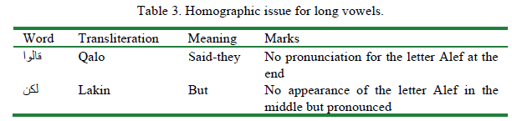
Vowels

Slide 60
Lack of uniformity in writing styles
The high level of ambiguity of the Arabic script poses special challenges to developers of NLP areas such as Morphological Analysis, Named Entity Extraction and Machine Translation.
These difficulties are exacerbated by the lack of comprehensive lexical resources, such as proper noun databases, and the multiplicity of ambiguous transcription schemes.
The process of automatically transcribing a non-Arabic script into Arabic, is called Arabization.

Slide 61
Lack of uniformity in writing styles
For example, transcribing an NE such as the city of Washington into Arabic NE produces variants such as
واشنجطن , , واشنطن واشنغطن وشنطن ,
Arabizing is very difficult for many reasons; one is that Arabic has more speech sounds than Western European languages, which can ambiguously or erroneously lead to an NE having more variants.

Slide 62
Summary
Lack of consistency in orthography
Hamza Spelling
Nonappearance of capital letters
Inherent ambiguity in named entities
Lack of uniformity in writing styles
Arabic word has different meaning depending on how it is discretized.

Slide 63
Arabic Morphology

Slide 64
Morphology is intricate
Arabic is a Semitic language that has a powerful morphology and a flexible word order.
Arabic morphology and sentence structure give the ability to incorporate a broad number of adds to each word which makes the combinatorial expansion of possible words.

Slide 65
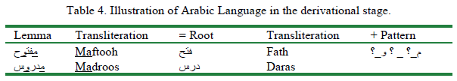
Morphology is intricate
Arabic is highly derivational. All the Arabic verbs are derived from a base of three or four characters’ root verb.
Deductions in Arabic are quite often templatic; hence, we can say simply that: Lemma = Root + Pattern.
Additionally, in case of a general deduction we can realize the significance of a lemma on the off chance that we know the root and Lemma, which have been utilized to determine it.

Slide 66
Morphology declension
Arabic is highly inflectional.
The prefixes can be articles, relational words or conjunctions, though the suffixes are by and large protests or individual/possessive anaphora.
Both prefixes and suffixes are permitted to be mixes, and along these lines a word can have zero or more affixes, i.e.
Word = Prefix(es) + Lemma + Suffix(es).

Slide 67
Morphology declension
Arabic verb morphology is central to the construction of an Arabic sentence because of its richness of form and meaning.
A more complicated example would be words that could represent an entire sentence in English such as
سيحضرونها and they will bring it, wasayahdurunaha).
This word can be written in this form:
وسيحضرونها = و+ س + ي + حضر + ون + ها
(wa+sa+ya+hdr+runa+ha, and+will+bring+they +it )

Slide 68
Morphology declension
Another morphological challenge with regard to relationships between words.
The syntactic relationship that a word has with alternate words in the sentence shows itself in its inflectional endings and not in the spot in connection to alternate words in that sentence.
For example, المعلم المخلص يحترمه طلابه, the faithful teacher is respected by his students, the suffix pronoun هـHeh in the two words يحترمه , respectedhim, and طلابه, students-his) refers to the word المعلم

Slide 69
Annexation
Another morphologic challenge in Arabic language is that we can compose a word to another by a conjunction of two words.
This conjunction can be with nouns, verbs, or particles. Although it is not common in traditional Arabic language, it is used in Modern Standard Arabic.
Usually, the compound word is semantically transparent such that the meaning of the compound word is compositional in the sense that the meaning of the whole is equal to the meaning of parts put together.
For example, the word رأسمالية capitalism, rasimalia comes from compound of two nouns رأس المال

Slide 70
Syntactic levels

Slide 71
Syntax is intricate
Arabic grammar distinguishes between two types of sentences: verbal and nominal.
Verbal sentences usually begin with a verb, and they have at least a verb (فعل) and a subject فاعل) ).
The subject as well as the object can be indicated by the conjugation of the verb, and not written separately.

Slide 72
Syntax is intricate
For example, the conjugated verb “ شاهدتك I saw you, saw-I-you, shahidtuk) has a subject and an object suffix pronouns attached to it.
Another example of a verbal sentence is “ يدرس الولد studying the boy, “yadrus alwald”).
This type of sentence is not applied in English sentences.
All the English sentences begin with a subject, and followed by a verb, for example, “the boy is studying”.

Slide 73
Syntax is intricate
In Arabic, a nominal sentence begins with a noun or a pronoun.
The nominal sentence has two parts: a subject or topic مبتدأ, and a predicate خبر khabar).
This verb is not given in Arabic.
Instead, it is implied and understood from the context.
For example, الطقس جميل has two nouns without a verb.
its English translation is “The Weather [is] wonderful”.

Slide 74
Multi word expressions
Multi word expressions are very important constructs because their total semantics usually cannot be determined by adding up the semantics of the parts.
For example, فقر الدم Anemia, faqar alddam) that consists of two words that has the literal meaning “ فقر poor, faqar and دم blood, dam).

Slide 75
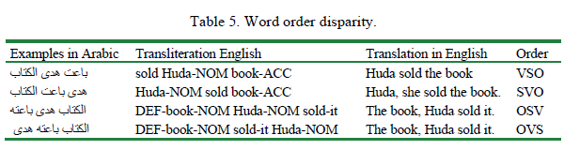
Syntactically flexible text sequence
Arabic is generally a free word request language.
While the essential word order in Classical Arabic and Modern Standard Arabic is verb-subject-object (VSO), they likewise permit subject-verb-object (SVO), object-subject-verb(OSV) and object-verb-subject (OVS).
This makes the sentence generation of Arabic NLP applications a challenge.

Slide 76
Task

Slide 77
Practical (using Python)
How to do Stemming on Arabic Text ?

